Slide 1
AI for Civic &
Legal Empowerment
What We're Solving
Rights exist — but remain systematically underutilized
Bridging the Bureaucracy Gap with Autonomous, Grounded AI Agents
Procedures are opaque — buried in PDFs and legal jargon
Hackathon Track
Problem Statement 3
A multi-agent AI platform that translates citizen grievances into structured, actionable legal and civic steps — grounded in verified government sources.
Citizens are priced out — of legal guidance for basic grievances
AI can close the gap — with grounded, conversational agents

Slide 2



The Problem: Citizen Friction
India's legal and civic framework provides extensive rights — consumer protection, tenant rights, RTI, welfare entitlements — yet the vast majority of citizens never exercise them. The barrier is not awareness; it is access.
The Bureaucratic
Maze
Rights and entitlements exist across consumer protection, tenant rights, RTI, and welfare schemes — but remain chronically underutilized due to confusing statutory language, fragmented portals, and overlapping jurisdictions. Citizens face a labyrinth with no map.
Procedural
Rejection
Citizens lack guidance on filing formats, applicable timelines, and correct jurisdiction. The result: improperly filed applications are rejected, disputes are abandoned, and rights violations go unaddressed — perpetuating a cycle of disempowerment.
Information
Trapped in PDFs
Crucial procedural steps are scattered across complex government circulars, multi-page legal documents, and gazette notifications. There is no single, authoritative, plain-language source that tells a citizen exactly what to do next.

Slide 3
Proposed Solution & Core Value Proposition
A conversational, multi-agent AI assistant that translates complex citizen grievances into structured, actionable legal and civic steps — grounded strictly in verified government sources.
PLAIN-LANGUAGE DEMYSTIFICATION
Converts dense legal jargon and statutory language into simple, step-by-step actionable roadmaps that any citizen can follow — regardless of legal literacy.
AUTOMATED ARTIFACT GENERATION
Pre-populates compliant RTI requests under Section 6(1), formal dispute notices, consumer complaint drafts, and eligibility forms — ready to file, not just to read.
GROUNDED RELIABILITY
Retrieval-augmented generation anchored exclusively to verified government portals and statutory frameworks — eliminating hallucinated procedures and fabricated legal steps.
Who It Serves
Tenants facing unlawful deposit deductions or eviction
Consumers with unresolved product/service disputes
Citizens seeking government information via RTI
Low-income individuals identifying welfare scheme eligibility
Core Design Principle
Every output is traceable to a statutory source. Citizens receive not just guidance, but verifiable references — empowering them to act with confidence and independently verify every step.

Slide 4
Technical Pipeline & Guardrails
The platform's reliability rests on a three-layer technical architecture: structured ingestion of government documents, retrieval-augmented generation anchored to verified sources, and mandatory safety guardrails that prevent harm and ensure appropriate escalation.
1
INGESTION & PARSING
Source Corpus
RTI Act, 2005 & official manuals
Consumer Protection Act, 2019
State-specific Rent Control Acts
NALSA scheme guidelines
Central & state welfare portal data
Official gazette notifications
OCR and PDF-parsing pipeline continuously ingesting public notices, official gazettes, government circulars, and statutory forms. Structured extraction converts unstructured documents into queryable knowledge chunks.
2
RETRIEVAL-AUGMENTED GENERATION (RAG)
Vector search anchored strictly to state and central government portals. No generation occurs without a retrieved, verified source passage — ensuring every procedural step has a traceable origin.
GuardraILS & DISCLAIMERS
Key Technical Constraint
All retrieval is jurisdiction-filtered. A query about tenant rights in Maharashtra returns Maharashtra Rent Control Act procedures — not generic or Delhi-specific guidance.
3
Automatic escalation triggers route complex cases to legal aid networks (e.g., NALSA). Mandatory "informational guidance, not legal counsel" disclaimers accompany every output. Confidence thresholds gate generation quality.

Slide 5


Live Demo: User Flow Walkthrough
The following walkthrough illustrates the end-to-end agent pipeline using a representative tenant dispute scenario — one of the most common civic grievances filed in India.
Step 1: User Input
Plain-language complaint: "My landlord deducted my security deposit without receipts or itemized deductions."
Step 2: Agent Processing
Intake Agent extracts jurisdiction, tenancy dates, and lease status. Rights Navigator identifies applicable Rent Control Act and Consumer Forum pathway.
Step 3: Generated Output
Step-by-step dispute resolution roadmap, formal demand notice draft, and consumer dispute filing steps if unresolved — all pre-filled and ready to submit.
What the Citizen Receives
Jurisdiction-specific legal rights summary
Formal demand notice (pre-filled, downloadable)
Consumer Forum complaint draft if landlord is unresponsive
Timeline: 30-day notice → Forum filing → Hearing schedule
Time to Actionable Output
What previously required a ₹5,000–₹50,000 legal consultation or hours of independent research is delivered in under 3 minutes — with full statutory citations included.

Slide 6




Impact, Feasibility & Next Steps
Impact Metrics
~3min
DRAFTING TIME
Down from hours of independent research or expensive legal consultation
Future Roadmap
MULTILINGUAL VOICE I/O
Voice-in/voice-out support for low-literacy users across regional languages — removing the text barrier entirely.
REJECTION RATE
Procedurally compliant outputs reduce filing rejections caused by format and jurisdiction errors
PORTAL API INTEGRATION
Direct API integration with grievance portals (e.g., CPGRAMS, state RTI portals) for one-click submission.
CIVIC AWARENESS
Citizens learn their rights through the process of exercising them — building long-term legal literacy
OFFLINE-FIRST MOBILE
Offline-capable mobile application for citizens in low-connectivity rural and semi-urban areas.

Slide 7




Why This Matters: The Rights Gap
The gap between rights on paper and rights in practice is not a legal problem — it is an access and information problem. AI is uniquely positioned to close it at scale.
Awareness vs. Access
Time & Cost Barriers
The Rejection Cascade
Improperly filed applications are rejected on procedural grounds. Rejection discourages re-filing. Repeated rejection normalizes the violation — and the citizen gives up. This cascade is the primary mechanism by which rights go unenforced.
Citizens broadly know that rights exist — consumer protection, RTI, tenant protections — but do not know how to exercise them. This creates a massive implementation gap that legal awareness campaigns alone cannot close.
Legal consultation for even simple grievances averages ₹5,000–₹50,000+ — pricing out the low- and middle-income citizens who most need protection. Time costs compound this: navigating portals independently can take days.
The platform targets the implementation gap — not legal reform. The laws are already sufficient. The missing layer is accessible, reliable procedural guidance at the moment a citizen needs it.

Slide 8
System Architecture: Sub-Agents
The platform operates as a coordinated ecosystem of four specialist sub-agents, each optimized for a distinct class of civic and legal task. An intake layer routes each grievance to the appropriate agent based on complaint type and jurisdiction.
RTI DRAFTER
Input: Raw citizen question or information need
Output: Section 6(1)-compliant RTI application with designated Public Information Officer (PIO) mapping and correct department routing.
RIGHTS NAVIGATOR
Input: Dispute context (tenant, consumer, workplace, civic)
Output: Actionable procedural pathways and jurisdiction-specific timeline roadmaps with applicable statutes identified.
ELIGIBILITY MATCHER
Input: User demographic criteria (income, location, category)
Output: Personalized checklist of qualifying welfare schemes with required documents and application portals.
CONVERSATIONAL FORM-FILLER
Input: Multi-turn interview capturing required data slots
Output: Downloadable pre-filled PDF and application drafts ready for submission to the relevant authority.

Slide 9

How It Works: The Agent Ecosystem
Our multi-agent system operates as an intelligent triage and drafting engine — combining intake intelligence, specialist routing, grounded generation, and artifact delivery into a seamless citizen-facing experience.
1
Intake Agent
Intake Agent
Listens to the citizen's plain-language complaint and extracts key structured facts: jurisdiction, relevant dates, parties involved, and grievance category. No legal knowledge required from the user.
2
Specialist Routing
Routes the structured complaint to the appropriate specialist sub-agent — Rights Navigator, RTI Drafter, Eligibility Matcher, or Form-Filler — based on grievance type and extracted context.
Specialist Routing
3
Grounded Generation
Each specialist agent retrieves verified procedures from indexed government sources and generates compliant, jurisdiction-specific outputs. No step is generated without a retrieved source passage.
Grounded Generation
4
Artifact Delivery
Returns downloadable, pre-filled documents — RTI applications, demand notices, complaint drafts, eligibility checklists — ready for immediate submission to the relevant authority.
Artifact Delivery

Slide 10
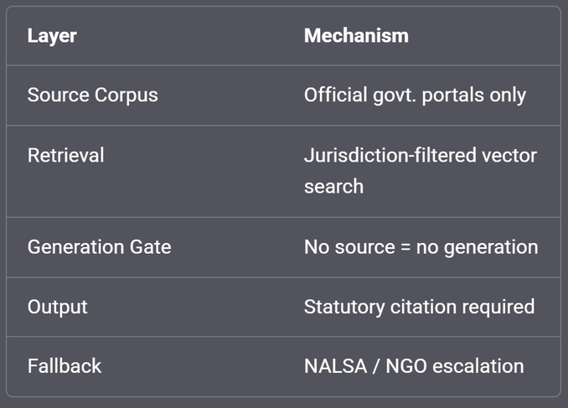
Grounding Strategy: Eliminating Hallucinations
Impact Metrics
VERIFIED SOURCE INDEXING
Vector embeddings of official RTI manuals, the Consumer Protection Act 2019, state-specific Rent Control Acts, tenant laws, and welfare scheme guidelines form the exclusive retrieval corpus. No external or unverified sources are indexed.
In civic and legal contexts, a hallucinated procedure is not merely unhelpful — it can cause direct harm: missed deadlines, wrong jurisdictions, invalid filings. Our grounding architecture makes hallucination structurally difficult.
JURISDICTION-AWARE RETRIEVAL
All retrieval is automatically filtered by state. A query about tenant rights returns Maharashtra Rent Control Act procedures for a Mumbai user — not generic or Delhi-specific guidance. Jurisdiction is extracted at intake and propagated through every agent call.
Grounding Architecture Summary
CITATION & TRACEABILITY
Every generated step includes a statutory reference — e.g., "Section 12, Consumer Protection Act, 2019" — so users can independently verify the guidance. Traceability is a core output requirement, not an optional feature.
Design Principle
The system is designed to know what it doesn't know — and to route accordingly. Confident silence is always preferable to confident error in a legal context.
Fallback to Human Escalation
If the system's confidence score drops below a defined threshold — due to ambiguous jurisdiction, novel fact patterns, or low retrieval relevance — the system escalates to legal aid networks (NALSA, partner NGOs) rather than generating a low-confidence response.

